Slide 1
Compound Interest – FV & PV
Unit 9

Slide 2
Learning Objectives
1. Calculate interest rates and the number of compounding periods
2. Compute future (maturity) values of investments
3. Compute present values of future sums of money
4. Discount long-term promissory notes
5. Solve problems involving equivalent values

Slide 3
Compound Interest – What is it?
Interest in earlier periods earns interest in future periods
Interest for a certain time period is computed using the original principal plus all the interest earned in prior periods
  Note that the interest for the first period is the same as computed using simple interest

Slide 4
Comparison – Simple vs Compound
Battle of Interest
Principal of $10,000 invested for a term of 5 years at 10% per Annum (p.a.)
Interest Calculation: I = Prt, where t is one period (1 year)
Term is the length of time of the investment

Slide 5

Key Formula!!
To compute future value (FV) using compound interest, we use the following formula:
          PV is the Principal Value
          i is the periodic rate of interest
          n is the number of compounding periods in the term
$$FV=PV{\left(1+i\right)}^{n}$$
Future Value using simple interest calculations uses the formula S=P(1+rt)

Slide 6
Periodic Rate of Interest versus Nominal Rate of Interest
Periodic interest is the interest rate per period, not to be confused with the nominal annual rate of interest
“4% p.a. compounded semi-annually” is an example of a nominal annual rate of interest
  p.a indicates “per annum”
  Compounded semi-annually indicates interest is compounded twice per year (more in a bit)
2% (every six months – twice per year) is the corresponding periodic rate of interest

Slide 7
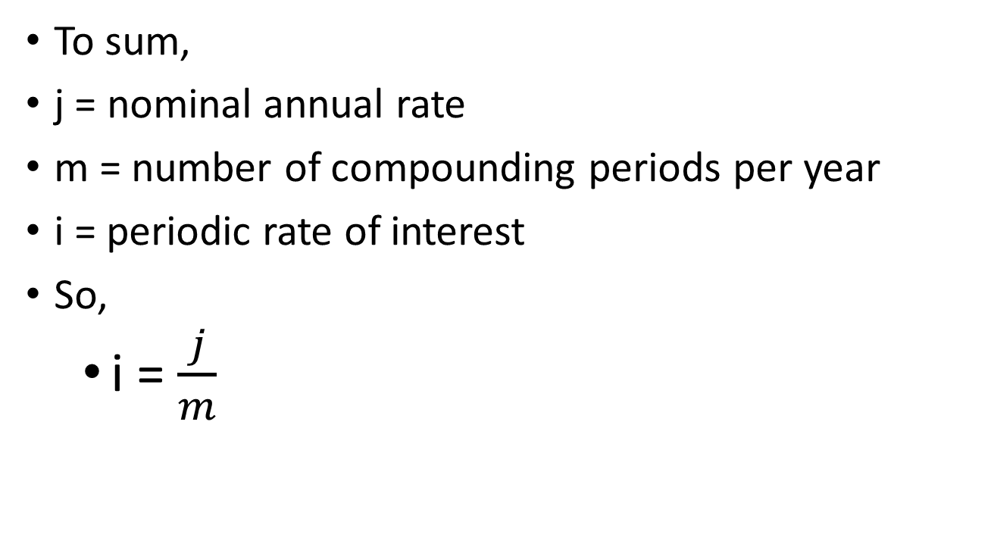
Periodic Rate of Interest versus Nominal Rate of Interest - Notation
To sum,
j = nominal annual rate
m = number of compounding periods per year
i = periodic rate of interest
So,
  i = $\frac{j}{m}$

Slide 8
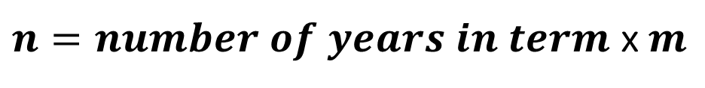
Number of Compounding Periods (n)
The term of an investment or loan is the length of time money is invested or loaned in total (usually stated in years or months)
The number of compounding periods is the total number of compounding periods in the term of the investment
$n=number of years in term$x$m$

Slide 9
Practice
For a sum of money invested at 2.4% compounded semi-annually for 3.5 years, state
  The nominal annual rate of interest (j)
  The number of compounding periods per year (m)
  The periodic rate of interest (i)
  The number of compounding periods in the term (n)
  The compounding factor (1+i)^{n}
  The numerical value of the compounding factor

Slide 10
Applying the FV formula
A deposit of $1,000 earns interest at 4% p.a. compounded quarterly for three years and five months. At that time, the interest rate changes to 6% p.a. compounded monthly. What is the value of the deposit two years after the change in the rate of interest?

Slide 11
Solution
There are two major calculations, FV₁ and FV₂
FV₁
  i = 4%/4 = 1.00% (0.01) every three months
  n = 3*4 + 1.6666667 = 13.666667 periods
    FV₁ = 1,000(1+0.01)^{13.666667} = $1145.667983
FV₂
  i = 6%/12 = 0.5% (0.005) every month
  n= 2 years x 12 = 24 periods
    FV₂ = $1145.667983(1+0.005)²⁴ = $1291.35

Slide 12
A Time Line of the Event
Now
3y5m (4.416667y)
5.416667y
2y
i=4%/4 = 1.00% = 0.01
n=3.416667 years x 4 times per year
= 13.666667 periods (quarters)
i=6%/12 =0.5%=0.005 periods
n=2 years x 12 times per year
= 34 periods (months)
$1,000
$1145.667983
$1291.35

Slide 13
FV Practice Questions
Q1. A debt of $8000 is payable in 7 years and 5 months. Determine the accumulated value of the debt at 10.8% p.a. compounded annually
Q2. A variable rate demand loan showed an initial balance of $2,000, payments of $500 after 18 months, $400 after 30 months, and a final payment after 5 years. Interest was 5.5% compounded semi-annually for the first two years and 6.5% compounded monthly for the remaining time. What was the size of the final payment?
Notes:
Q1. FV=8000(1+.108/1)^7.416667 = 17116.96

Slide 14


Present Value (PV) and Compound Discount
The principal that will grow to the given amount if compounded at a given periodic rate of interest over a given number of conversion periods is the Present Value
Present Value Formula:
  which can also be expressed as:
$$PV=\frac{FV}{{\left(1+i\right)}^{n}}$$
$$PV=FV{\left(1+i\right)}^{−n}$$

Slide 15
Key Point!!
Difference between the known future amount and the computed present value (principal) is the compound discount and represents the compound interest accumulating on the computed present value
    Compound Discount = FV – PV

Slide 16
Calculator Tips –
Cash Flow Conventions
Cash flow = cash payment
Cash INFLOW : represents $$$ to us -> enter as a positive value
Cash OUTFLOW: represents $$$ from us -> enter as a negative value

Slide 17
Calculator Tips
Increasing the number of decimals in TI BAII Plus
  Will show how in class

Slide 18
Practice Questions - PV
Q1. How much would you have to deposit in an account today to have $2000 in a five year term deposit at maturity if interest is 2.75% compounded semi-annually?
Q2. In negotiating a contract for your business, you have to decide between receiving $65,000 now or $25,000 now and $45,000 three years from now. In terms of today’s dollar, which choice is better and by how much? Money is worth 4.25% compounded annually.

Slide 19
Discounting Non-Interest-Bearing Promissory Notes
The face value of a non-interest-bearing note is also its maturity value
The proceeds of a non-interest-bearing note are the present value of its face value at the date of discount
face value=maturity value
maturity date
issue date
discount date
discount period

Slide 20
Discounting Non-Interest-Bearing Promissory Notes
Find the proceeds of a non-interest bearing note for $5,000 discounted 2 years before maturity. The interest rate is 3% compounded monthly
The maturity value is equal to the face value
  i=3%/12=0.25%=0.0025 per period (month)
  n=2 years x 12 times per year = 24 periods
$$PV={5,000\left(1+0.0025\right)}^{−24}=\$4,709.18 (proceeds)$$

Slide 21
Discounting an Interest-Bearing Promissory Note
The proceeds of an interest-bearing note are equal to the present value (of the maturity value of the note) at the date of discount
Two steps are required:
1. Determine the maturity value of the note
  use the note’s stated interest rate and the entire length of the note
2. Determine the proceeds by discounting the maturity value
  find the present value using the prevailing interest rate and the time between the discount date and the maturity date
Notes:
Note the 2 step process – finding a FV then a PV

Slide 22
Discounting an Interest-Bearing Promissory Note
On April 1, 2014, a three-year promissory note for $5,000 is issued with an interest rate of 6% compounded semi-annually. The note is discounted on April 1, 2016 at 8% compounded quarterly. Find the proceeds of the note
Proceeds = discounted value?
April 1, 2016
maturity value?
April 1, 2017
$5,000
April 1, 2014
discount period
1 year = 4 quarters

Slide 23

Discounting an Interest-Bearing Promissory Note
Maturity value
  i=6%/2=3%=0.03 every six months
  n=3 years x 2 times per year = 6 periods in the term
Proceeds (Discounted Value)
  i=8%/4=2%=0.02 every 3 months (quarter)
  n=1 year x 4 times per year = 4 periods
$$FV=5,000{\left(1+0.03\right)}^{6}=\$5,970.261483$$
$$PV=5,970.261483{\left(1+0.02\right)}^{−4}=\$5,515.60$$

Slide 24
Practice – Promissory Note
Q1. Find the proceeds of a $1000, four year note bearing interest at 2% compounded quarterly, discounted two and a half years after the date of issue at 3% compounded monthly.

Slide 25
More Promissory Note Questions
Q2. A seven year, non-interest bearing note for $10000 is discounted 3 years and 8 months before its due date at 4% compounded quarterly. Find the proceeds of the note.
Q3. A $2800 promissory note issued without interest for five years on Jan 13, 2016, is discounted on June 30, 2020, at 6% compounded quarterly. Find the compound discount.

Slide 26
Equivalent Values
Amounts of money have different values at different times (Time Value of Money)
When sums of money fall due or are payable at different times, they are not directly comparable
To make such sums of money comparable, a point in time (comparison/focal date) must be chosen for the comparison

Slide 27


Equivalent Values
If the due date of the payment falls before the focal date, use the FV formula
If the due date of the payment falls after the focal date, use the PV formula
$$FV=PV{\left(1+i\right)}^{n}$$
$$PV=FV{\left(1+i\right)}^{−n}$$

Slide 28
Calculating Equivalent Values (payments)
Debt payments of $500 due three months ago, $1,000 due today, and $2,000 due in fifteen months are to be combined into one payment due six months from today at 12% p.a. compounded monthly
Find the size of that payment
Equivalent Payment?
6 months
from today
$2,000
15 months
from today
$500 due
3 months ago
$1,000
today

Slide 29

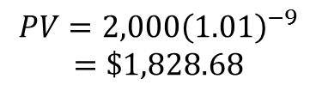
Calculating Equivalent Values (payments)
i=12%/12=1% per period (month)
Equivalent Payment?
6 months
from today
Focal date
$2,000
15 months
from today
$500 due
3 months ago
$1,000
Today (0)
n=6 periods (months)
E₂
n=15-6=9 periods
(months)
$$FV={1,000\left(1+0.01\right)}^{6}=\$1,061.52$$
E₃
n=3+6=9 periods (months)
$$PV=2,000{\left(1.01\right)}^{−9}$$
$$=\$1,828.68$$
$$FV=500{\left(1+0.01\right)}^{9}=\$546.84$$
E₁

Slide 30
Calculating Equivalent Values (payments)
From the graphic we can see that the equivalent payment at month six is calculated to be E₁+E₂+E₃:
Summary
Equivalent Payment | Amount
E₁ | $546.84
E₂ | $1,61.52
E₃ | $1,828.68
Total | $3,437.04

Slide 31
Two or More Equivalent
Replacement Payments
An equation of values matching the dated values of the original scheduled payments against the dated values of the proposed replacement payments on a selected focal date should be set up
  (the focal date is arbitrary)
Equivalent value of original payment(s) at the focal date = Equivalent value of replacement payment(s) at the focal date

Slide 32
Two or More Equivalent
Replacement Payment
Joe is due to make a payment of $2,500 now. Instead, he has negotiated to make two equal payments one year and two years from now. Determine the size of the equal payments if money is worth 7.5% compounded quarterly.
  The focal date can be arbitrary but it should be chosen to reduce the number and complexity of the calculation
  Choose today as the focal date for convenience

Slide 33
Two or More Equivalent
Replacement Payment
i=7.5%/4=1.875% per period (quarter)
We call the unknown replacement payments
both ‘x’ as they are equivalent
$2,500
Today = now
x
1 year
x
2 years
n=1 x 4=4 periods
E₁
Focal date
$$PV=x{\left(1+0.01875\right)}^{−4}=0.928389x$$
n=2 x 4 = 8 periods
E₂
$$PV=x{\left(1+0.01875\right)}^{−8}=0.861904258x$$

Slide 34
Two or More Equivalent
Replacement Payments
From the graphic we can see that the equivalent payment at the focal date is calculated to be E₁+E₂=1.790292x
1.790292x = 2,500
x=$1,396.42 is the size of each replacement payment
 | Replacement payments
E1 | 0.928388x
E2 | 0.861904x
Total | 1.790292x

Slide 35
Equivalent Payment Questions
Q1. Scheduled payments of $800 due one year ago and $1000 due six months ago are to be replaced by a payment of $400 now, a second payment of $1000 nine months from now, and a final payment 18 months from now. What is the size of the final payment if interest is 10.8% compounded quarterly?

Slide 36
More Questions
Q2. A loan of $15000 borrowed today is to be repaid in three equal installments due in one year, three years, and five years, respectively. What is the size of the equal installments if money is worth 6.2% compounded monthly?

Slide 37
More Questions
Q3. A payment of $500 is due in six months. Interest is compounded quarterly at 4% the first six months and is compounded at 6% monthly thereafter. A second payment of $800 is due in 18 months. These two payments are to be replaced by a single payment nine months from now. Determine the size of the replacement payment nine months from today if the focal date is nine months from now.

Slide 38
Summary
With compound interest, earned interest is added to the principal and thus “interest is earned on interest” resulting in exponential growth
The Future Value (maturity value) of an investment using compound interest can be expressed by the formula FV = PV(1+i)^{n}
The Present Value (discount) of an investment using compound interest can be expressed by the formula PV = FV(1+i)^{-n}

Slide 39
Summary
The discounting of promissory notes involves discounting (PV) using the period from the maturity date back to the discount date
There are two types of promissory notes, interest bearing and non-interest bearing
The equivalent value of a series of payments can be found using the sum of FV and/or PV calculations

