Slide 1
Review of Linear Systems with Graphing
Unit 6

Slide 2
Learning Objectives
1. Solve linear systems consisting of two simultaneous equations in two variables using algebraic elimination
2. Graph linear equalities in two variables
3. Graph linear systems consisting of two linear relations in two variables
4. Solve problems by setting up systems of linear equations in two variables

Slide 3
Solving Linear Systems with Two Variables
Any linear system that consists of two equations in two variables can be solved algebraically or graphically
Solving a system of two equations requires finding a pair of values for the two variables that satisfies both of the equations
Algebraic and graphic solutions of systems of linear equations in two variables are used extensively when doing break-even analysis

Slide 4
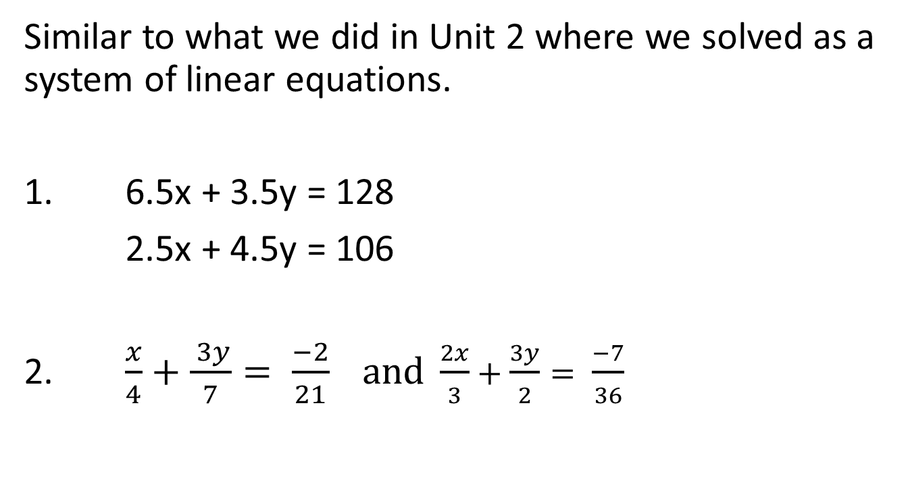
Practice Problems
Similar to what we did in Unit 2 where we solved as a system of linear equations.
1. 6.5x + 3.5y = 128
2.5x + 4.5y = 106
2. $\frac{x}{4}+\frac{ 3y}{7}= \frac{−2}{21} and \frac{2x}{3}+\frac{3y}{2}= \frac{−7}{36}$

Slide 5
Graphing Linear Systems of Equations in Two Unknowns
Q1. 6x + 3y = 300 for x=0 to x=50 and 4x+8y=160 for x=0 to x=80
We will do this one together

Slide 6
Problem Solving
Q1. A machine requires four hours to make a unit of Product A and three hours to make a unit of Product B. Last month the machine operated for 200 hours, producing a total of 60 units. How many units of each type of product did it produce?
Q2. A company has two plants: plant 1 and plant 2. Product 1 requires 3 hours of processing time at plant 1 and 4 hours at plant 2. Product 2 requires 4 hours of processing time at plant 1 and 6 hours at plant 2. Plant 1 has 30 hours of processing time available and plant 2 has 40 hours. How many units of each product will the company produce? (The wording on this problem seems a little trickier than Q1 but in reality both are approached similiarly)
Notice how it looks very similar to a unit 2 problem!

Slide 7
Graphing Inequalities
Recommended Problems
Question 1.
Graph the region where x - 2y < 4 and x > -3
Question 2
Graph the region where 5x > -3y and 2x – 5y > 10
This is a “doing” type of problem
First, we graph the line (i.e. pretend it is an equality relationship)
Second, we check if the inequality area is above or below the line or to the right or left of the line. Using the origin is useful here - (0,0) is an easy coordinate to use ☺

Slide 8
Summary
Linear systems of two simultaneous equations in two variables are useful for modeling business applications
Such systems can be solved by graphing the two linear equations and finding the point of intersection
Such systems can be solved algebraically by using the method of elimination

