Slide 1
Simple Interest
Unit 5

Slide 2
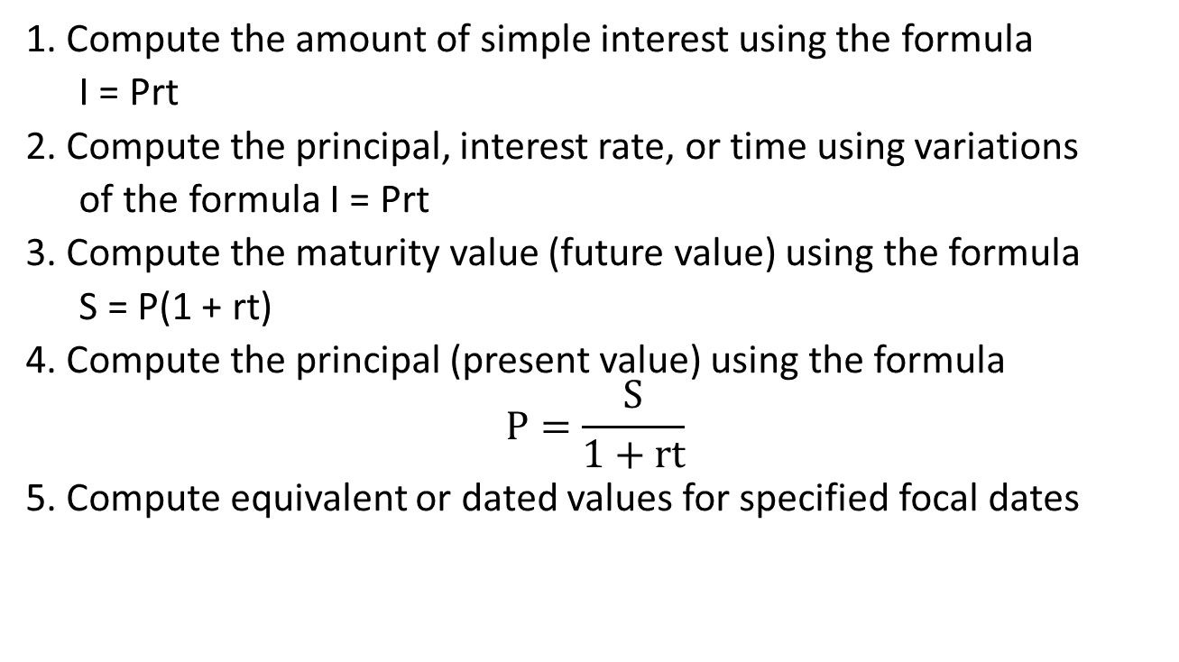
Objectives
1. Compute the amount of simple interest using the formula
I = Prt
2. Compute the principal, interest rate, or time using variations
of the formula I = Prt
3. Compute the maturity value (future value) using the formula
S = P(1 + rt)
4. Compute the principal (present value) using the formula
$$P=\frac{S}{1+rt}$$
5. Compute equivalent or dated values for specified focal dates

Slide 3
Simple Interest – What is it?
Transactions in business often involve the daily borrowing or lending of money
To compensate the lenders interest is paid
  Think of it as rent charged for the use of money
Interest paid is based on three factors: the amount of money borrowed, the rate of interest at and the time period for which it is borrowed

Slide 4
Transactions Involving Simple Interest
Term deposits and other short-term investments
Canada savings bonds
Credit card transactions
Purchases on credit from vendors
Short-term loans

Slide 5

Calculation of Simple Interest
Formula
  I is the amount of interest earned
  P is the principal sum of money earning the interest,
  r is the simple annual (yearly or nominal) rate of interest
    expressed as a percent, which can be converted into a decimal
  t is the interest period in years (usually)
  Note the difference between r (RATE of interest) and I (AMOUNT of interest).
$$I=Prt$$

Slide 6
Computing Days Between Two Dates
Will demonstrate in class – most convenient to use your calculator
We will use both the BA II Plus and the TI 83/84

Slide 7
Matching r and t
When using the simple interest formula, it is imperative that the time t correspond to the interest rate r
  Time expressed in months or days often needs to be converted into years
    Months ➔ Years (divide by 12)
    Days ➔ Years (divide by 365)
  Alternatively if the interest rate is per month the time needs to be in months
    The same is true for days

Slide 8
Practice Questions
Q8. RMB Equipment charged interest at 2% p.a. on overdue accounts. An invoice for $21,000 plus interest, was paid 35 days past the due date. How much interest was paid?

Slide 9
Practice Question
Q16. Mac’s credit card statement included $360 in cash advances and $3.20 in interest charges. The interest rate on the statement was 13.5%. For how many days was Mac charged interest?

Slide 10

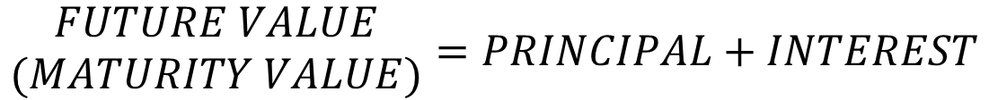
Computing Future Value
(Maturity Value)
When you borrow money, you are obligated to repay, at some point in the future both
  the sum borrowed (the principal)
  any interest due
$$\begin{matrix}FUTURE VALUE \\ (MATURITY VALUE)\end{matrix}=PRINCIPAL+INTEREST$$
$$S=P+I$$

Slide 11
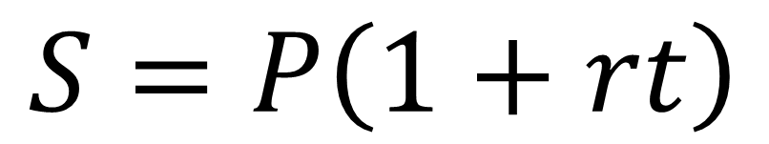
Computing Future Value
(Maturity Value)
Since I = Prt
S = P + I
Then S = P + Prt
  We can simplify this
$$S=P\left(1+rt\right)$$

Slide 12
Practice Questions
Q6. Prairie Grains Cooperative wants to invest $45,000 in a short term deposit. The bank offers 1.3% interest for a one year term and 1.1% for a six month term.
  A. How much Prairie Grains receive if the $45,000 is invested for one year?
  B. How much would Prairie Grains receive at the end of one year if the $45,000 is invested for six months and then the principal and interest earned is reinvested for another six months.
  C. What would the one year rate have to be to yield the same amount of interest as the investment described in part (b)?

Slide 13
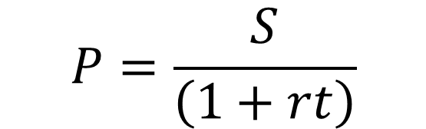
Finding the Principal (Present Value)
The present value of an amount at any given time is the principal needed to grow to a desired amount at a given rate of interest over a given period of time
Both formulas give the same answer. I like this one better as it is easier to use when calculating equivalent payments
$$P=\frac{S}{\left(1+rt\right)}$$

Slide 14
Practice Questions
Q8. On March 15, 2020, Ben bought a government guaranteed short term investment maturing on September 12, 2020. How much did Ben pay for the investment if he will receive $10,000 on September 12, 2020, and interest is 2.06%?

Slide 15

Equivalent Payments - Choosing Between Finding S and P
Select a focal date or comparison date.
If the due date falls before the focal date, find the future value by using S = P(1+rt).
If the due date falls after the focal date, find the present value
OR
$$P=\frac{S}{\left(1+rt\right)}$$

Slide 16
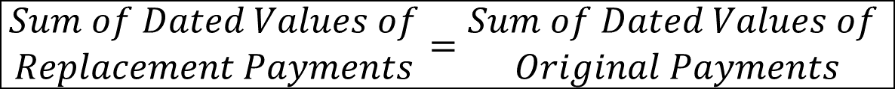
Equations of Values at Focal Date
To solve equations of value or replacement payments, make the sum of the dated values (equivalent payments) of the replacement payments equal to the sum of the dated values of the original payments
$$\begin{matrix}Sum of Dated Values of \\ Replacement Payments\end{matrix}=\begin{matrix}Sum of Dated Values of \\ Original Payments\end{matrix}$$

Slide 17
Loan Repayments
Loans by financial institutions to individuals are usually repaid by blended payments i.e. payments that include principal and interest
To repay the loan, the sum of the present values of the periodic payments must equal the original principal
This is called the Valuation Principle

Slide 18
Equivalent Payments - Example
Jane is owed payments of $500 four months ago, $800 today, and $400 in three months from Kristen. Both have agreed instead to make a single payment one month from today. If money is worth 6.5% and the agreed focal date is one month from today, what is the size of the replacement payment?
Important first step – draw a timeline!!

Slide 19
Equivalent Payment Practice
Q12. Judy received a payment of $2950 and used it to pay back two equal outstanding loans from 45 days ago and 190 days ago. If interest is 12.5% on the loans, and the agreed focal date is today, what was the size of the equal amounts borrowed?
Q16. On March 1, Bear Mountain Tours borrowed $1500. Three equal payments are required, on April 30, June 20, and August 10, as well as a final payment of $400 on September 30 of the same year. If the focal date is September 30, what is the amount of the equal payments at 6.75%?

