Slide 1
Trade Discounts, Cash Discounts, Markup, and Markdown
Unit 4

Slide 2
Objectives
Solve problems involving trade discounts
Calculate equivalent single rates of discount for a discount series
Apply methods of cash discount
Solve problems involving markup based on either cost of selling price
Solve problems involving markdown
Solve integrated problems involving discounts, markup, and markdown

Slide 3

Supply Chain
The supply chain defines the channels or stages that a product passes through as it is converted from a raw material to a finished product purchased by the consumer

Slide 4
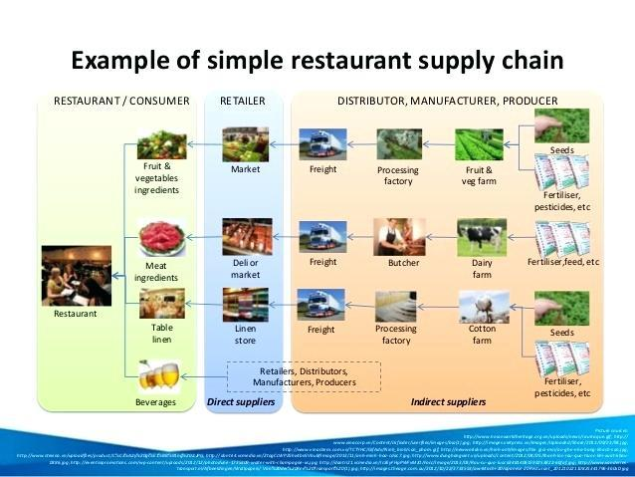

Slide 5
Supply Chain
In some supply chains, the distributor and wholesaler are separated
In other supply chains, the manufacturer also serves as the wholesaler
Within the supply chain, all of the channels must make a profit on the product to remain in business

Slide 6
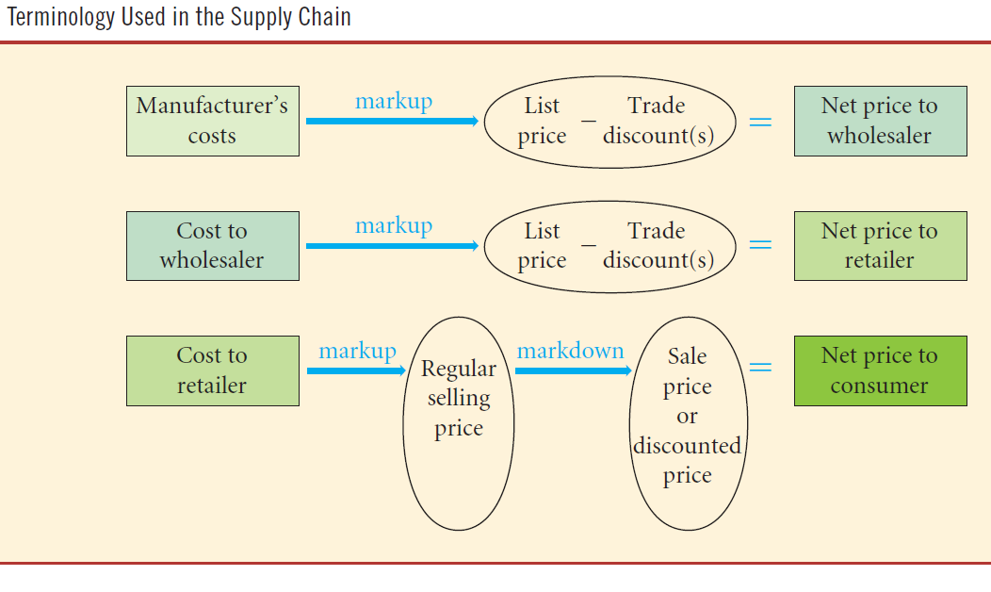
Supply Chain
Notes:
From Pearson Custom 2nd Edition for MacEwan University.

Slide 7
Selling Price
Components of the selling price
Selling Price
Profit ☺
Expenses (indirect)
Cost (direct)
Components of Selling Price

Slide 8
Trade Discount
A trade discount is a reduction of a list price or manufacturer’s suggested retail price (MSRP)
  Usually stated as a percent of the list price or MSRP
Trade discounts are used by manufacturers, distributors, and wholesalers as pricing tools to
  determine different prices for different levels of the supply chain
  communicate changes in prices
  enable changes in prices

Slide 9


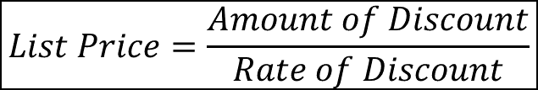
Trade Discount
Formulas
A = d × L or A = dL
L = $\frac{A}{d}$
$$\begin{matrix}Amount \\ of Discount\end{matrix}=\begin{matrix}Rate of \\ Discount\end{matrix}×\begin{matrix}List \\ Price\end{matrix}$$
$$List Price=\frac{Amount of Discount}{Rate of Discount}$$

Slide 10


Trade Discount
Formulas
d = $\frac{A}{L}$
N= L - A
$$Rate of Discount= \frac{Amount of Discount}{List Price}$$
$$Net Price=List Price−Amount of Discount$$

Slide 11




The Net Price Factor Approach
Formulas
$$\begin{matrix}Net Price \\ Factor (NPF)\end{matrix}=100\%−\% Discount$$
$$Net Price=List Price×\begin{matrix}Net Price \\ Factor (NPF)\end{matrix}$$
$$Net Price factor\left(NPF\right)=1−d$$
$$N=L\left(1−d\right)$$
This is the important final formula

Slide 12
Discount Series
A manufacturer may offer two or more discounts to different members of the supply
Chain
  If a list price is subject to two or more discounts, these discounts are called a discount series
  Additional discounts offered to encourage large volume orders and early orders for seasonal items
  Additional discounts may be offered to different members of the merchandising chain

Slide 13
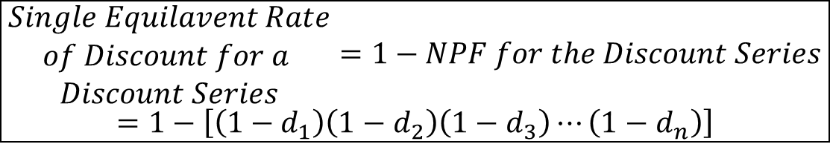
Discount Series
Formulas
For every discount series, a single equivalent rate of discount exists
Use if we have more than one discount rate
$$NET PRICE=L\left(1−d_{1}\right)\left(1−d_{2}\right)\left(1−d_{3}\right)⋯\left(1−d_{n}\right)$$
$$\begin{matrix}Single Equilavent Rate \\ of Discount for a \\ Discount Series\end{matrix}=1−NPF for the Discount Series$$
$$=1−\left[\left(1−d_{1}\right)\left(1−d_{2}\right)\left(1−d_{3}\right)⋯\left(1−d_{n}\right)\right]$$
Notes:
Equivalent refers to a single rate of discount that leaves us at the same price as a multitude of discounts

Slide 14
Questions
Golf World sells a set of golf clubs for $762.50 below the suggested retail price. Golf World claims that this represents a 62.5% discount. What is the suggested retail price (or list price)?
A mobile phone is listed for $174 less 162/3%, 10%, and 8%
  A. What is the net price?
  B. What is the total amount of discount allowed?
  C. What is the exact single rate of discount that was allowed?

Slide 15
Questions
An office desk listed at $440 less 25% and 15% is offered at a further reduced price of $274.89. What additional rate of discount was offered?

Slide 16
Payment Terms and Cash Discounts
An invoice for the goods is sent, and the seller specifies payment terms on the invoice
The business selling the goods can offer a cash discount to encourage prompt payment

Slide 17
Payment Terms and Cash Discounts
An invoice for the goods is sent, and the seller specifies payment terms on the invoice
The business selling the goods can offer a cash discount to encourage prompt payment

Slide 18
Payment Terms and Cash Discounts
All payment terms have three things in common:
The rate of discount is stated as a percent of the net amount of the invoice (the amount after trade discounts are deducted)
The discount period is stated
    indicating the time period when the cash discount can be applied
The credit period is stated
    indicating the time period when the invoice must be paid

Slide 19
Cash Discounts
Offered in a variety of ways:
Ordinary dating, whereby payment terms are based on the invoice date
End-of-month dating, or E.O.M. dating
  shift the invoice date to the last day of the month
Receipt-of-goods dating, or R.O.G
  used when the transportation of the goods takes a long time

Slide 20
A Sample Sales Invoice
terms of payment

Slide 21
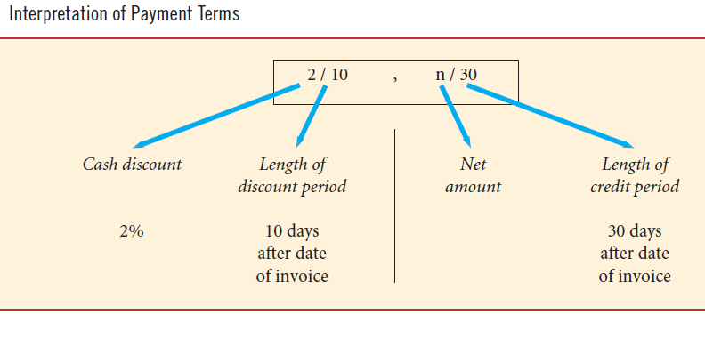
Interpretation of Payment Terms
Notes:
From Pearson 2nd Custom Edition for MacEwan University

Slide 22
Ordinary Dating
Commonly used payment terms are 2/10, n/30 (read “two ten, net thirty”)
  if payment is made within 10 days of the date of the invoice, a discount of 2% may be deducted from the net amount of the invoice
  otherwise, payment of the net amount of the invoice is due within 30 days

Slide 23
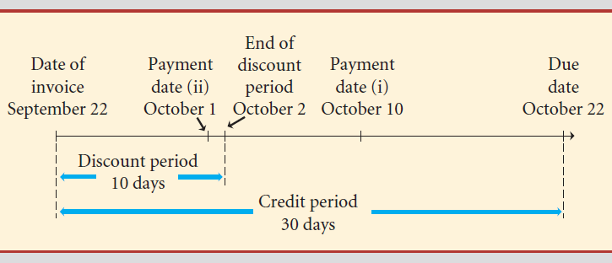
Ordinary Dating
Determine the payment needed to settle an invoice with a net amount of $950, dated September 22, terms 2/10, n/30, if the invoice is paid
on October 10;
on October 1
Notes:
Timeline from From Pearson 2nd Custom Edition for MacEwan University

Slide 24
Ordinary Dating
Ten days after September 22 is October 2. The discount period ends October 2
October 10 is beyond the last day for taking the discount, the full amount of the invoice of $950 must be paid
October 1 is within the discount period; the 2% discount can be taken
Amount paid = Net amount − 2% of the net amount
= 950.00 − 0.02(950.00)
= 950.00 − 19.00
= $931.00

Slide 25
End-of-the-Month Dating
Commonly the credit period (such as n/30) is not stated
  In our example, “2/10, n/30 E.O.M.” would be written “2/10 E.O.M

Slide 26
End-of-the-Month Dating
An invoice for $1,233.95 dated July 16, terms 2/10 E.O.M., is paid on August 10. What is the amount paid?
  the invoice is to be treated as if the invoice date were July 31
  the last day for taking the discount is August 10
We start counting from the end of the month which is July 31 in this example – Aug 1 is day 1, Aug 2 is day 2 and so on with Aug 10 being day 10. Payment on Aug 10 is discounted by 2%.
Amount paid = 1233.95(1-0.02) = $1209.27

Slide 27
Receipt-of-Goods Dating
Hansa Import Distributors has received an invoice of $8465.00 dated May 10, terms 3/10, n/30 R.O.G., for a shipment of clocks that arrived on July 15
What is the last day for taking the cash discount and how much is to be paid if the discount is taken?
  Last day for taking the discount is ten days after receipt of the shipment, that is, July 25
Less commonly used.

Slide 28
Partial Payment
When a business pays part of an invoice within the discount period the purchaser is entitled to the cash discount on the partial amount paid
Very important point!

Slide 29
Questions
Q1. Busby Bus Services received an invoice for $2750 dated June 22 with terms 3/15, 1/30, n/60
  a. If the invoice is paid on June 30, how much is to be paid?
  b. If the invoice is paid on August 15, how much is to be paid?
Q2. What amount will reduce the amount due on an invoice of $2750 by $740 if the terms of the invoice are 5/10, n/30 and the payment was made during the discount period?
Q3. A payment of $650 is made within the discount period on an invoice of $2400. The terms of the invoice are 5/10, n/60. How much remains owing after the payment?
Notes:
Q1. a. $2667.50
b. $2750
Q2. payment amount = $703.
Q3. credit amount = $684.21 so amount owing = 2400-684.21=$1715.79

Slide 30



Markup
Selling Price (S) | Markup (M) | Profit (P)
 |  | Expenses (E)
 | Cost (C) | Cost
$$S=C+E+P$$
$$M=E+P$$
therefore
$$S=C+M$$

Slide 31
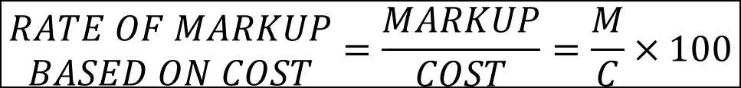
Rate of Markup
Markup may be stated in one of two ways:
as a percent of cost; or
as a percent of selling price
$$\begin{matrix}RATE OF MARKUP \\ BASED ON COST\end{matrix}=\frac{MARKUP}{COST}=\frac{M}{C}×100$$
$$\begin{matrix}RATE OF MARKUP \\ BASED ON SELLING PRICE\end{matrix}=\frac{MARKUP}{SELLING PRICE}=\frac{M}{S}×100$$

Slide 32
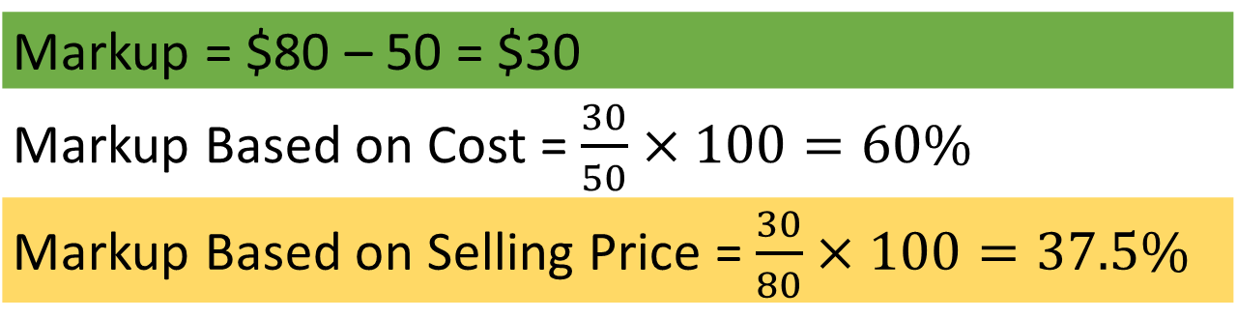
Finding the Rate of Markup
The cost of a electronic book reader to the retailer is $50 and can be sold for $80
Markup = $80 – 50 = $30
Markup Based on Cost = $\frac{30}{50}×100=60\%$
Markup Based on Selling Price = $\frac{30}{80}×100=37.5\%$

Slide 33
Practice Questions
Q1. Lodgepole pine trees were purchased for $3.50 each less 40%, and less a further 25%. They were sold for $3.29
  A. What is the markup as a percent of cost?
  B. What is the markup as a percent of selling price?
Q2. Ultimate Ski purchased gloves for $80.28 per pair. The gloves are marked up 48% of the selling price.
  A. For how much does Ultimate Ski sell a pair of gloves?
  B. What is the rate of markup based on cost?
Notes:
Q1. a. 122% b. 55%
Q2. a. $154.38 b. 92.3%

Slide 34
Markdown
Reduction in price of article sold to customer
Stated as a percent of the price to be reduced
Computed as if it were a discount
Selling Price (S) | Markup (M) | Profit (P) | Markdown (MD)
 |  | Expenses (E) | Sale (reduced price)
 | Cost (C) | Cost

Slide 35
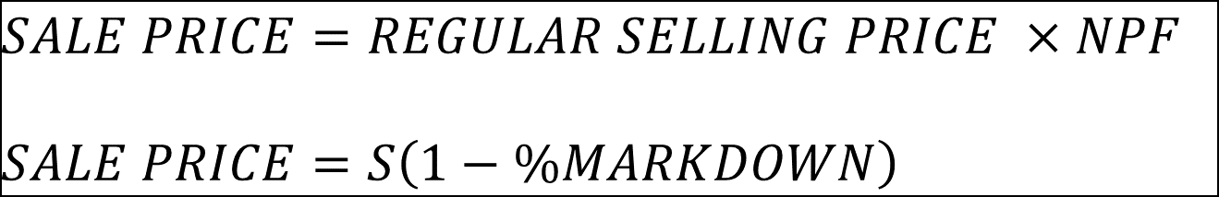
Markdown
Sale Price = Regular Selling Price – Markdown
Since the markdown is a percent of the regular selling price
$$MARKDOWN RATE=\frac{MARKDOWN}{REGULAR SELLING PRICE}=\frac{MD}{S}×100$$
$$SALE PRICE=REGULAR SELLING PRICE ×NPF$$
$$SALE PRICE=S\left(1−\%MARKDOWN\right)$$

Slide 36
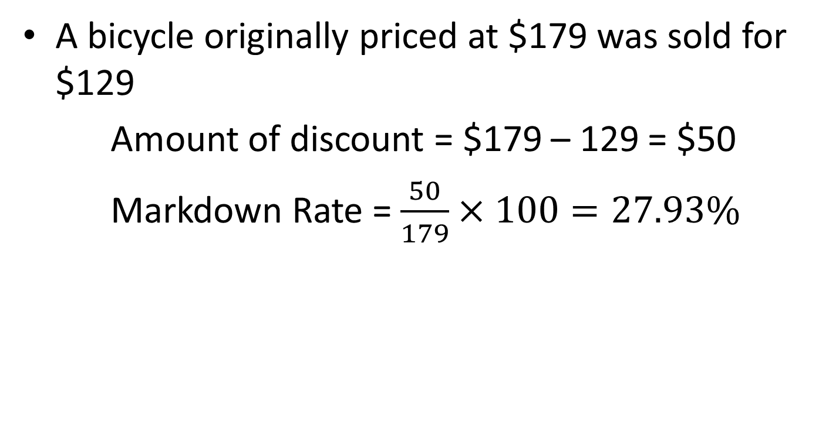
Markdown
A bicycle originally priced at $179 was sold for $129
Amount of discount = $179 – 129 = $50
Markdown Rate = $\frac{50}{179}×100=27.93\%$

Slide 37
Markdown Practice Questions
Q1. A seven day spa vacation in Sunnybrook was advertised at a price of $799 per person based on double occupancy. If the vacation was booked two months in advance, the price would be lowered to $685 per person. What rate of markdown has been offered?
Notes:
14.268%

Slide 38
Markdown Practice Questions
Q2. Amazing Aways Company sells sightseeing tours of the Kootenay Plains Ecological Reserve for $3849 per person. Overhead expenses for the company are 31% of cost and the target profit is 17% of cost
  A. How much does Amazing Aways pay for the tours?
  B. What is the lowest price they can offer while covering all of the costs and expenses?
  C. What is the highest rate of markdown at which the company will still break even?
Notes:
C=$2600.68
$3406.89
11.49%

Slide 39
Unit Practice Questions
Q1. Valemount Ski and Cycle purchases ski boots for $360 per pair less 33.33333% and 10%. The regular rate of markup on selling price of the boots is 35%. The store’s overhead is 22% of the selling price. During a January clearance sale, the price was reduced to $270 per pair.
  A. what was the rate of markdown for the sale?
  B. what was the profit or loss on each pair of boots at the sale price?
  C. at the sale price, what was the rate of markup on cost?
  D. At the regular selling price, what was the rate of markup on selling price?
Notes:
MD=0.1875
Loss = 19.11
25%
35%

Slide 40
Unit Practice Questions
Q2. Valleyview Building Supply obtains 4ft by 8ft sheets of wallboard from Candian Gypsum at $30 per sheet less 30% and 10%. The price is to be set to cover Valleyview’s overhead of 20% of the selling price and to provide an operating profit of 18% of the selling price.
  A. What should be the retail price per sheet?
  B. what is the maximum amount of markdown to break even?
Notes:
S= $30.48
18%

Slide 41
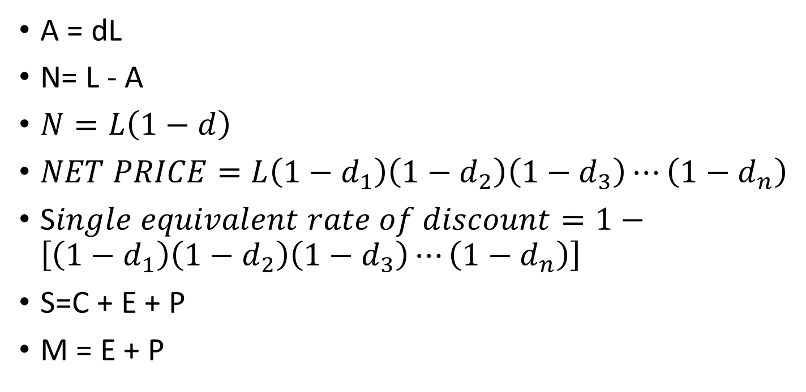
Formula Summary
A = dL
N= L - A
$N=L\left(1−d\right)$
$NET PRICE=L\left(1−d_{1}\right)\left(1−d_{2}\right)\left(1−d_{3}\right)⋯\left(1−d_{n}\right)$
S$ingle equivalent rate of discount=1−\left[\left(1−d_{1}\right)\left(1−d_{2}\right)\left(1−d_{3}\right)⋯\left(1−d_{n}\right)\right]$
S=C + E + P
M = E + P

Slide 42
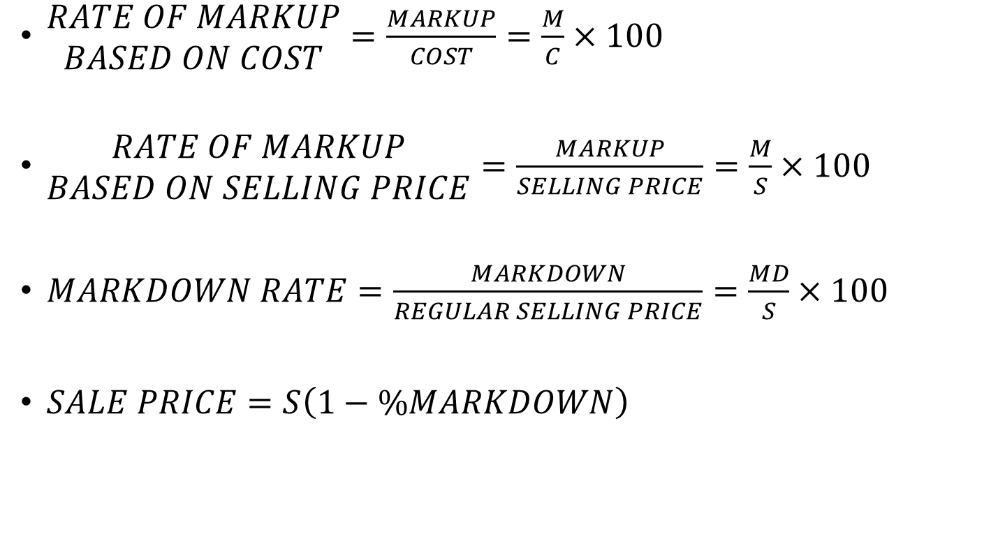
Formula Summary
$\begin{matrix}RATE OF MARKUP \\ BASED ON COST\end{matrix}=\frac{MARKUP}{COST}=\frac{M}{C}×100$
$\begin{matrix}RATE OF MARKUP \\ BASED ON SELLING PRICE\end{matrix}=\frac{MARKUP}{SELLING PRICE}=\frac{M}{S}×100$
$MARKDOWN RATE=\frac{MARKDOWN}{REGULAR SELLING PRICE}=\frac{MD}{S}×100$
$SALE PRICE=S\left(1−\%MARKDOWN\right)$

