Slide 1
Ordinary Simple and General Annuities
Unit 10

Slide 2
Learning Objectives
Distinguish between types of annuities based on term, Payment date, and conversion period
Compute the future value for ordinary simple annuities
Compute the present value for ordinary simple annuities
Compute the payment for ordinary simple annuities
Compute the number of periods for ordinary simple annuities
Compute the interest rate for ordinary simple annuities

Slide 3
What is an Annuity?
Definitions
  An annuity is a series of payments, usually of equal size, made at periodic intervals
  The Payment Interval is the time between the successive payments
  The payment period is the length of time from the beginning of the first payment
  The term of the annuity is the interval to the end of the last payment interval

Slide 4
Annuity Examples
Examples of annuities:
  Residential mortgages
  Car loans or leases
  Student loan payments
    Each of these examples involve equal payments between equal periods of time , for example monthly, bi-monthly etc.
    Typical payment periods are monthly, quarterly, semi-annually and yearly

Slide 5
Types of Annuities
Simple and general annuities
Ordinary annuities and annuities due
Deferred annuities
Perpetuities
Annuities certain and contingent annuities

Slide 6
Types of Annuities
Simple and general annuities
  In a simple annuity, the conversion period is the same length as the payment interval
    An example is when there are monthly payments on a loan for which the interest is compounded monthly
    We will discuss this type on the current set of slides
  In a general annuity, the conversion period and the payment interval are not equal
    For a residential mortgage, interest is compounded semi-annually but payments may be made monthly, semi-monthly, bi-weekly, or weekly
    We will discuss this type on the next set of annuity slides

Slide 7
Types of Annuities
Ordinary annuities and annuities due
  In an ordinary annuity, payments are made at the end of each payment period
    Loan payments, mortgage payments, and interest payments on bonds are all examples of ordinary annuities
  In an annuity due, payments are made at the beginning of each payment period
    Examples of annuities due include lease rental payments on real estate or equipment
    Car leases

Slide 8
Types of Annuities
Deferred annuities
  The first payment is delayed for a period of time
    Example: A severance amount may be deposited into a fund that earns interest, and then later converted into another fund that pays out a series of payments until the fund is exhausted
    Don’t pay until___________ sales
    Really just a combination of compound interest and annuity concepts

Slide 9
Types of Annuities
Perpetuities
  An annuity for which the payments continue forever
  When the size of the periodic payment from a fund is equal to or less than the periodic interest earned by the fund a perpetuity is the result
    Example: An endowment fund to a university or a continuous benefit from a capital investment, UK gilts (these have reappeared).

Slide 10
Types of Annuities
Annuities certain and contingent annuities
  If both the beginning date and ending date of an annuity are known, indicating a fixed term, the classification is an annuity certain
    Example: lease payments on equipment, instalment payments on loans, and interest payments on bonds
  If the beginning date, the ending date, or both, are unknown, the classification is a contingent annuity
    Example: life insurance premiums or pension payments – dependent on an event like retiring which doesn’t necessarily happen on a date certain.

Slide 11
Ordinary Simple Annuity
Payments are made at the end of each payment interval (Ordinary) and the interest conversion period and payment interval are the same (Simple)

Slide 12
Ordinary Simple Annuity
Example
  The interest rate is 6% p.a. compounded annually
  Five payments of $1000 at the end of every year (annually)
Now
End of year 1
End of year 2
End of year 3
End of year 4
End of year 5
$1000
$1000
$1000
$1000
$1000
Notes:
Timeline and example courtesy of Pearson

Slide 13
Future Value of an Ordinary Simple Annuity after 5 Years
The maturity value (FV) of this annuity is:
Now
End of year 1
End of year 2
End of year 3
End of year 4
End of year 5
Focal Date
$1000
$1000
$1000
$1000
$1000
1 year
2 years
3 years
4 years
This is tedious to compute, so we develop a formula.
Notes:
Timeline and example courtesy of Pearson

Slide 14
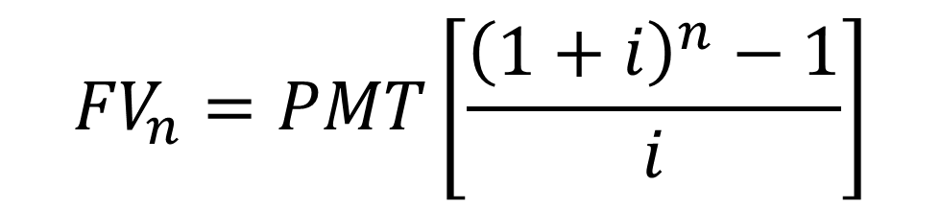
Annuity Formula - FV
FV of a Ordinary Simple Annuity
No. of payments in total
$${FV}_{n}=PMT\left[\frac{{\left(1+i\right)}^{n}−1}{i}\right]$$
Periodic interest rate
Payment per period
is called the compounding or accumulation factor
for annuities or the accumulated value of one dollar per period

Slide 15
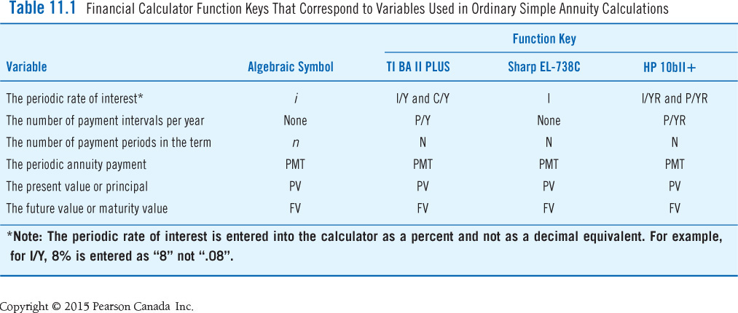
Calculator Registers
Let’s discuss how to do this with our calculators.

Slide 16
Basic Calculator Registers
N = number payments
I = nominal interest rate
PV = present value, principal value
PMT = payment per period
FV = future value or lump sum payment at the end of the term
p/y = number of payments per year
c/y = number of compoundings per year
The above represent the key parameters in the annuity calculator. We fill what we know, solve for the single parameter we are interested in (or don’t know)

Slide 17
Practice Questions
Q1. Joey made ordinary annuity payments of $25 per month for 22 years, earning 4.5% compounded monthly. How much interest is included in the future value of the annuity?
Q2. Courtney has saved $360 per quarter for the past three years in a savings account earning 4.2% compounded quarterly. She plans to leave the accumulated savings for seven years in the savings account at the same rate of interest.
  A. how much will Courtney have in total in her savings account?
  B. how much did she contribute?
  C. how much will be interest?

Slide 18
Present Value of an Ordinary Simple Annuity
Examine the time line
Now
End of year 1
End of year 2
End of year 3
End of year 4
End of year 5
Focal Date
1 year
$1000
$1000
$1000
$1000
$1000
2 years
3 years
4 years
5 years
This is tedious to compute, so we develop a formula
Notes:
Example courtesy of Pearson Canada

Slide 19
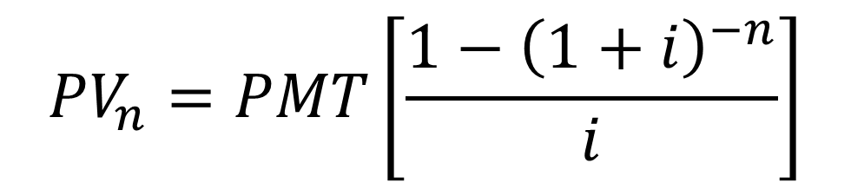
Annuity Formula - PV
PV of a Ordinary Simple Annuity
No. of payments in total
$${PV}_{n}=PMT\left[\frac{{1−\left(1+i\right)}^{−n}}{i}\right]$$
Periodic interest rate
Payment per period
Is called the present value factor or discount factor
for annuities or the discounted value of one dollar per period

Slide 20
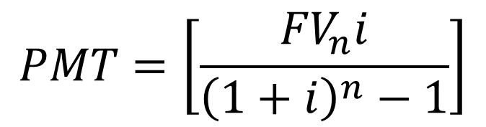
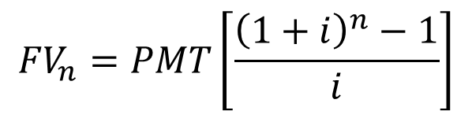
Ordinary Simple Annuities
Finding the Periodic Payment
When the future value of an annuity is known, use the FV formula for an ordinary simple annuity
Alternatively you can rearrange
$${FV}_{n}=PMT\left[\frac{{\left(1+i\right)}^{n}−1}{i}\right]$$
$$PMT=\left[\frac{{FV}_{n}i}{{\left(1+i\right)}^{n}−1}\right]$$
We use the calculator to do the actual calculation although it is useful to understand the math behind the calculator operations

Slide 21
Applications
A small initial payment on a large loan for a purchase (for example a property) is called a down payment
A mortgage loan from a financial institution is needed to supply the balance of the purchase price
The amount of the loan is the present value of the future periodic payments

Slide 22
Applications
The cash value is the price of the property at the date of purchase
CASH VALUE = DOWN PAYMENT + PRESENT VALUE OF THE PERIODIC PAYMENTS
(paid now)

Slide 23
Practice Questions
Q1. A sales contract for the purchase of a car requires payments of $352.17 at the end of each month for the next four years. Suppose interest is 6.4% p.a. compounded monthly.
  A. what is the amount financed? (same as asking for PV)
  B. how much is the interest cost?

Slide 24
More Practice Questions
Q2. Bird Construction agreed to lease payments of $742.79 on construction equipment to be made at the end of each month for three years. Financing is at 7% compounded monthly.
  A. what is the value of the original lease contract?
  B. if, due to delays, the first eight payments were deferred, how much money would be needed after nine months to bring the lease payments up to date?
  C. how much money would be required to pay off the lease after nine months (assuming no payments were made)?

Slide 25

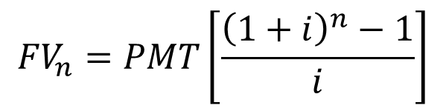
Finding the Term n
When the future value of an annuity is known
  Use the FV of an ordinary annuity formula and solve
Alternatively you can rearrange and develop a formula
$${FV}_{n}=PMT\left[\frac{{\left(1+i\right)}^{n}−1}{i}\right]$$
$$n=\frac{ln\left[\left(\frac{{FV}_{n}×i}{PMT}\right)+1\right]}{ln\left(1+i\right)}$$
Note: in general, FV and PMT must have the same sign

Slide 26
Finding the Periodic Rate of Interest i
Preprogrammed financial calculators are especially helpful when solving for the conversion rate I (periodic interest rate)
Determining i without a financial calculator is extremely time-consuming

Slide 27
Practice Questions
Q1. What payment is required at the end of each month for 12 years to repay a $197,000 mortgage if interest is 3.35% compounded monthly?
Q2. Starting three months after their daughter Megan’s birth, her parents made deposits of $120 into a trust fund every three months until she was 21 years old. The trust fund provides for equal withdrawals at the end of each quarter for four years, beginning three months after the last deposit. If interest is 6.75% compounded quarterly, how much will Megan receive every three months?
Notes:
“Starting three months after” is just a way of saying end of the quarter.

Slide 28
Practice Questions
Q3. Rand borrowed $35,476 to buy a new Honda Accord, payments were $553 per month for four years. What is the nominal interest rate for this loan? (Assume nominal interest rate is compounded monthly).

Slide 29
Effective Rate of Interest
Effective rates of interest are the equivalent rates of interest compounded annually
Formula
  f = (1 + i)^{m} - 1
Can also use calculator – will show in class.
In Alberta you will see the effective rate of interest in every loan contract – often called the APR (annual percentage rate)

Slide 30
Ordinary General Annuity
Similar to simple annuities except p/y ≠ c/y
On the calculator we change p/y first then c/y.
See next set of annuity slides for details.

Slide 31
Summary
The ordinary simple annuity satisfies the following two conditions:
  Payments are made at the end of the interest conversion interval with the first payment at the end of the first interval ( Ordinary)
  The payment period interval and the interest conversion interval are equal (Simple)
Payments, number of payments can be solved using the appropriate version of the PMT and n formulas (FV or PV)
Solving for the conversion rate (periodic rate) i is tedious manually and is best solved using a programmed solution

