Slide 1
Linear Programming Modeling Applications with Computer Analyses in Excel plus Integer Programming
Linear Programming Part 2
Unit 8 (cont)

Slide 2
Learning Objectives
Model a wide variety of linear programming (LP) problems.
Understand major business application areas for LP problems, including manufacturing, marketing, finance, employee staffing, transportation, blending, and multiperiod planning.
Gain experience in setting up and solving LP problems using Excel’s Solver.

Slide 3
LP and Managerial Decisions
Product mix
Make-buy
Media selection
Marketing research
Portfolio selection
Shipping and transportation
Allocation decisions
Ingredient blending
Multiperiod scheduling

Slide 4
Steps in the Process
Define the decision variables
Formulate the LP model using the decision variables
Write the objective function equation
Write each of the constraint equations
Implement the model in Excel
Solve with Excel’s Solver

Slide 5
Media Selection Problem
Win Big Gambling Club advertising
Decision variables
T = number of 1-minute television spots taken each week
N = number of full-page daily newspaper ads taken each week
P = number of 30-second prime time radio spots taken each week
A = number of 1-minute afternoon radio spots taken each week

Slide 6
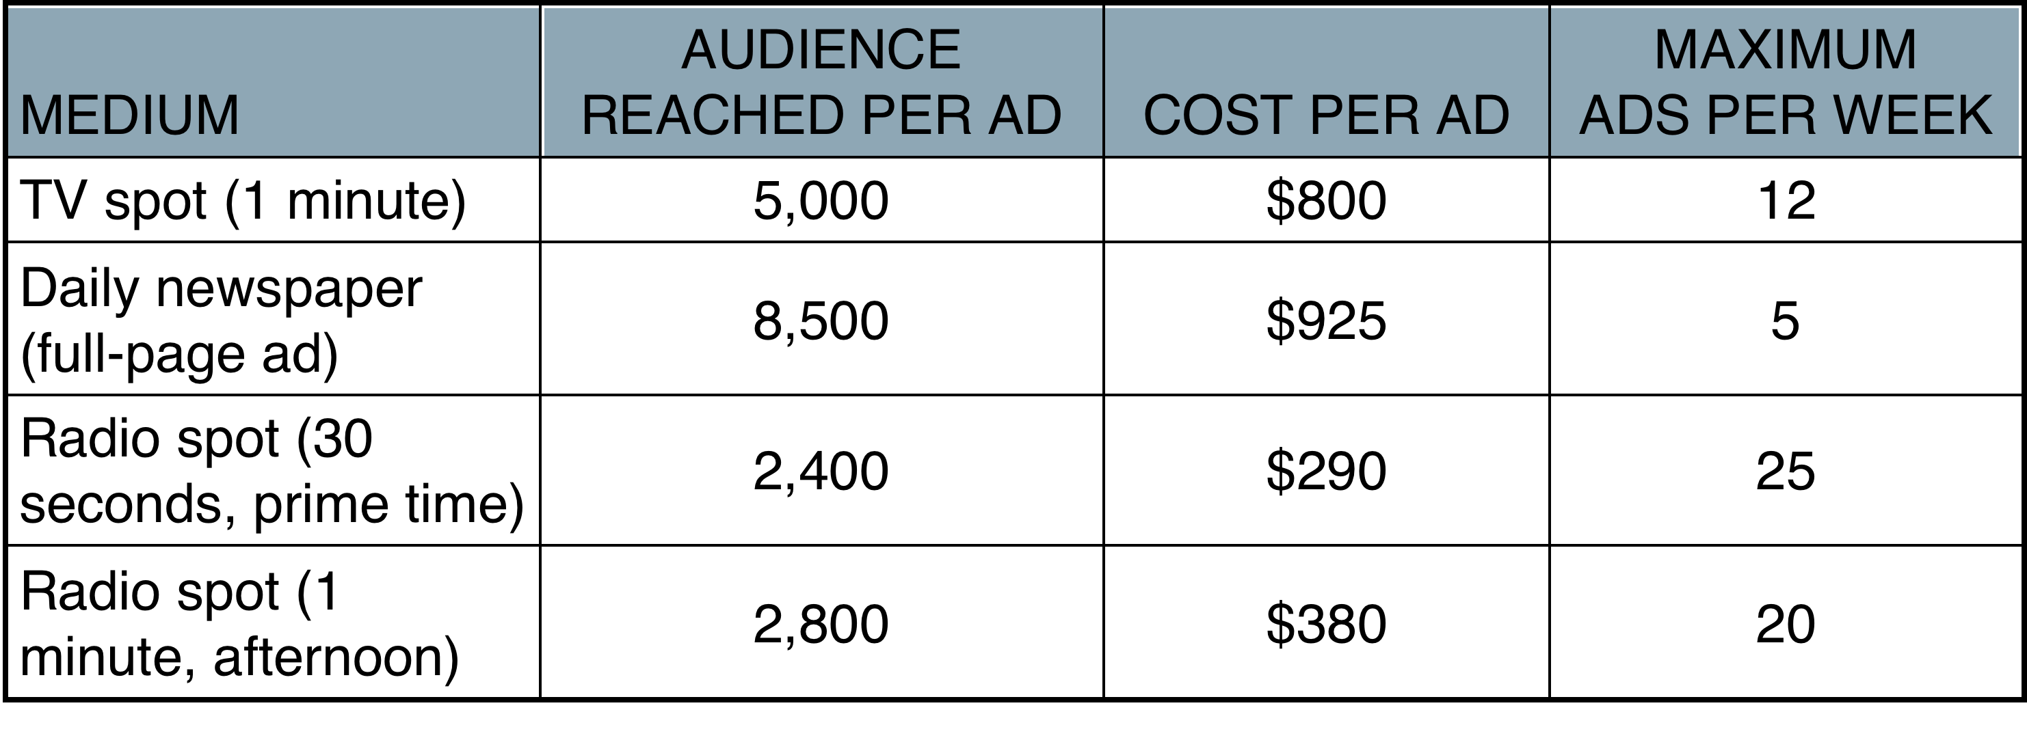
Media Selection Problem
Table 19.3

Slide 7
Media Selection Problem
Objective:
Maximize audience coverage = 5,000T + 8,500N + 2,400P + 2,800A
subject to
T ≤ 12 (max TV spots/week)
N ≤ 5 (max newspaper ads/week)
P ≤ 25 (max 30-second radio
spots/week)
A ≤ 20 (max 1-minute radio spots/week)
800T + 925N + 290P + 380A ≤ 8,000 (weekly advertising budget)
P + A ≥ 5 (min radio spots contracted)
290P + 380A ≤ 1,800 (max dollars spent on radio)
T, N, P, A ≥ 0 (nonnegativity)

Slide 8
Solving the Problem

Slide 9
Marketing Applications
Marketing Research Problem
MSA survey decision variables
B₁ = number surveyed who are ≤ 30 years of age and live in a border state
B₂ = number surveyed who are 31–50 years of age and live in a border state
B₃ = number surveyed who are ≥ 51 years of age and live in a border state
N₁ = number surveyed who are ≤ 30 years of age and do not live in a border state
N₂ = number surveyed who are 31–50 years of age and do not live in a border state
N₃ = number surveyed who are ≥ 51 years of age and do not live in a border state

Slide 10
Marketing Research Problem
Objective Function
Minimize total interview cost = $7.50B₁ + $6.80B₂ + $5.50B₃
+ $6.90N₁ + $7.25N₂ + $6.10N₃
subject to
B₁ + B₂ + B₃ + N₁ + N₂ + N₃ ≥ 2,300 (total number surveyed)
B₁ + N₁ ≥ 1,000 (persons 30 years or younger)
B₂ + N₂ ≥ 600 (persons 31–50 in age)
B₁ + B₂ + B₃ ≥ 0.15(B₁ + B₂ + B₃+ N₁ + N₂ + N₃) (border states)
N₁ ≥ 0.5(B₁ + N₁) (≤ 30 years, not border state)
B₃ ≤ 0.2(B₃ + N₃) (51+ years and border state)
B₁, B₂, B₃, N₁, N₂, N₃ ≥ 0 (nonnegativity)

Slide 11
Marketing Research Problem
Cost data
COST PER PERSON SURVEYED
REGION AGE ≤ 30 AGE 31–50 AGE ≥ 51
State bordering Mexico $7.50 $6.80 $5.50
State not bordering Mexico $6.90 $7.25 $6.10

Slide 12
Solving the Problem

Slide 13
Employee Staffing
Labor Planning Problem
Hong Kong Bank staffing requirements
TIME PERIOD NUMBER REQUIRED
9 a.m.–10 a.m. 10
10 a.m.–11 a.m. 12
11 a.m.–Noon 14
Noon–1 p.m. 16
1 p.m.–2 p.m. 18
2 p.m.–3 p.m. 17
3 p.m.–4 p.m. 15
4 p.m.–5 p.m. 10

Slide 14
Labor Planning Problem
Decision variables
F = number of full-time tellers (all starting at 9 a.m.)
P = number of part-timers, starting at 9 a.m. (leaving at 1 p.m.)
P₁ = number of part-timers, starting at 10 a.m. (leaving at 2 p.m.)
P₂ = number of part-timers, starting at 11 a.m. (leaving at 3 p.m.)
P₃ = number of part-timers, starting at noon (leaving at 4 p.m.)
P₄ = number of part-timers, starting at 1 p.m. (leaving at 5 p.m.)

Slide 15
Labor Planning Problem
Objective Function
Minimize total daily personnel cost = $90F + $28(P₁ + P₂ + P₃ + P₄ + P₅)
subject to
F + P₁ ≥ 10 (9 a.m. – 10 a.m. requirement)
F + P₁ + P₂ ≥ 12 (10 a.m. – 11 a.m. requirement)
0.5F + P₁ + P₂ + P₂ ≥ 14 (11 a.m. – 12 noon requirement)
0.5F + P₁ + P₂ + P₃ + P₄ ≥ 16 (12 noon – 1 p.m. requirement)
F + P₂ + P₃ + P₄ + P₅ ≥ 18 (1 p.m. – 2 p.m. requirement)
F + P₃ + P₄ + P₅ ≤ 17 (2 p.m. – 3 p.m. requirement)
F + P₄ + P₅ ≤ 17 (3 p.m. – 4 p.m. requirement)
F + P₅ ≤ 17 (4 p.m. – 5 p.m. requirement)
F ≤ 12 (full time tellers available)
4P₁ + 4P₂ + 4P₃ + 4P₄ + 4P₅ ≤ 56 (part time worker hours)
F, P₁, P₂, P₃, P₄, P₅ ≥ 0 (nonnegativity)

Slide 16
Solving the Problem

Slide 17
Finance Applications
Portfolio Selection Problem
International City Trust investment decisions
INVESTMENT INTEREST EARNED RISK SCORE
Trade credits 7% 1.7
Corporate bonds 10% 1.2
Gold stocks 19% 3.7
Platinum stocks 12% 2.4
Mortgage securities 8% 2.0
Construction loans 14% 2.9

Slide 18
Portfolio Selection Problem
Decision variables
T = dollars invested in trade credit
B = dollars invested in corporate bonds
G = dollars invested in gold stocks
P = dollars invested in platinum stocks
M = dollars invested in mortgage securities
C = dollars invested in construction loans

Slide 19
Portfolio Selection Problem
Objective function
Maximize dollars of interest earned = 0.07T + 0.10B + 0.19G
+ 0.12P + 0.08M + 0.14C
subject to
T + B + G + P + M + C ≤ 5,000,000
T ≤ 0.25(T + B + G + P + M + C)
B ≤ 0.25(T + B + G + P + M + C)
G ≤ 0.25(T + B + G + P + M + C)
P ≤ 0.25(T + B + G + P + M + C)
M ≤ 0.25(T + B + G + P + M + C)
C ≤ 0.25(T + B + G + P + M + C)
G + P ≥ 0.30(T + B + G + P + M + C)
T + B ≥ 0.45(T + B + G + P + M + C)
1.7T + 1.2B + 3.7G + 2.4P + 2.0M + 2.9C
T + B + G + P + M + C
≤ 2
T + B + G + P + M + C ≥ 0

Slide 20
Solving the Problem

Slide 21
Solving the Problem

Slide 22
Some Integer Programming Basics
Rounding off the LP solution might not yield the optimal IP solution
The IP objective function value is usually worse than the LP value
IP solutions are usually not at corner points

Slide 23
General Integer Variables
Harrison Electric Company
  Ornate lamps
  Old-fashioned ceiling fans
Lamps Fans Hours
Wiring 2 3 12
Assembly 6 5 30
Profit $600 $700

Slide 24
Harrison Electric
Decision Variables
L = number of lamps
F = number of ceiling
Integer values

Slide 25
Harrison Electric
Objective function
Maximize profit = $600L + $700F
subject to
2L + 3F ≤ 12 (wiring hours)
6L + 5F ≤ 30 (assembly hours)
L, F ≥ 0

Slide 26
Graphical Solution
6 –
5 –
4 –
3 –
2 –
1 –
–
Figure 6.1
F
+ = Integer Valued Point
6L + 5F ≤ 30
Rounded-off IP Solution
(L = 4, F = 2, Infeasible)
+
+
+
+
+
Optimal IP Solution
(L = 3.75, F = 1.50, Profit = $3,300)
+
+
+
+
2L + 3F ≤ 12
Nearest Feasible Rounded-off IP Solution
(L = 4, F = 1, Profit = $3,100)
| | | | | |
0 1 2 3 4 5 6
L

