Slide 1
Data Visualization
MGTS 113
Instructor: Allan Wesley

Slide 2
Key First Questions
Question 1. What is data visualization?
Using data to tell a story
Turning data into information
Question 2. Why do we represent data visually?
    We respond to visual stimuli

Slide 3
What are some principles to keep in mind when representing data visually?
Importance of Context
Who is your audience?
What do you need them to know?

Slide 4
Choose an Effective Visual
What is the best way to show your data?
Key Theme – Avoid cognitive overload
Tools: simple text, tables, heatmaps, line graphs, slope graphs, vertical bar chart.
Avoid: pie and donut charts, anything 3D
Key idea: unify the elements consistently in colors and fonts

Slide 5
Tools - Tables
See the transition, which one is easiest to read?

Slide 6
Tools - Heatmap

Slide 7
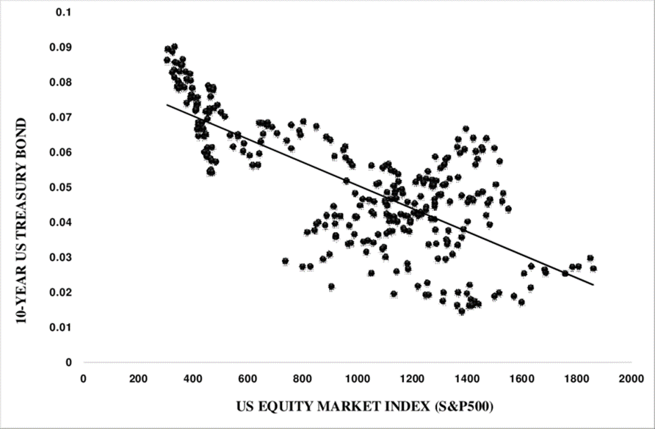
Tools - Scatterplot

Slide 8
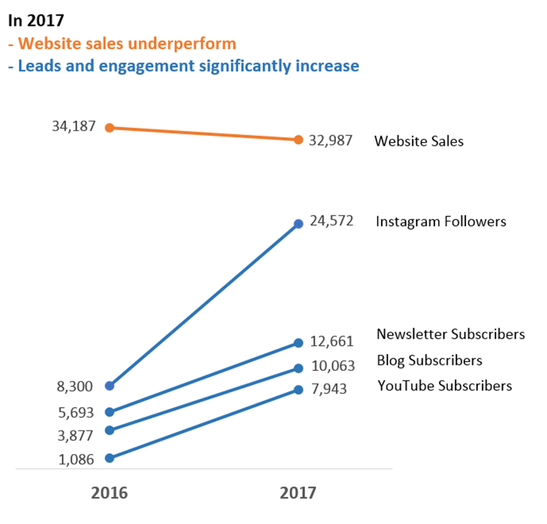
Tools – Line Graphs

Slide 9
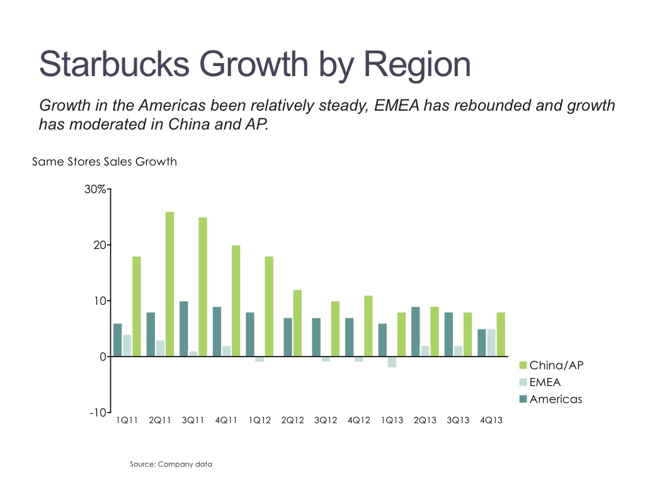
Tools – Bar Graphs
Easy to understand
Be aware of the starting point!

Slide 10
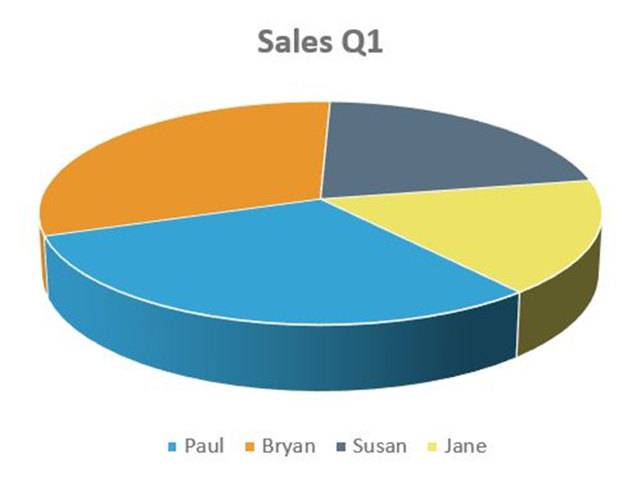
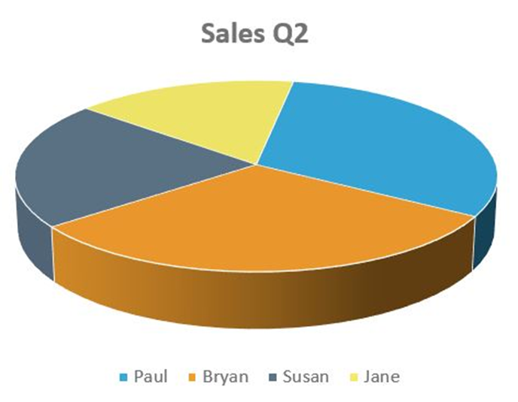
Practices to Avoid
Area graphs and pie charts
Why?

Slide 11
Other Considerations
Clutter is the Enemy
Visual Perception Issues to Consider
  Proximity
  Similarity
  Enclosure
  Closure

Slide 12
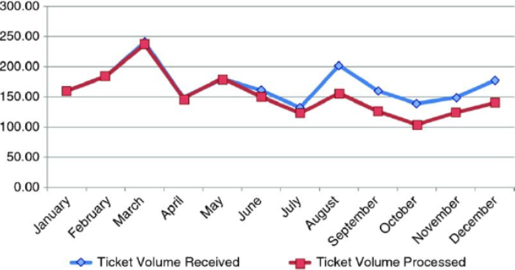
An Example
At the beginning
Step 1: Remove Chart Border

Slide 13
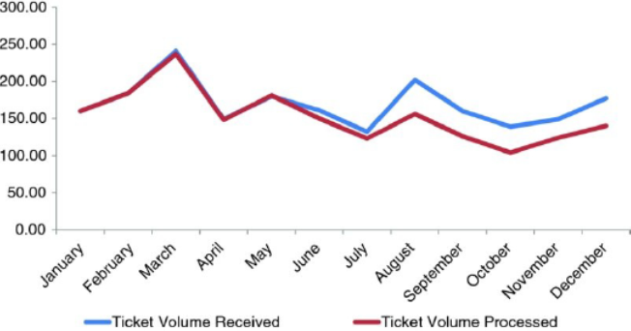
Example - cont
Step 3: Remove data markers
Step 2: Remove Gridlines

Slide 14
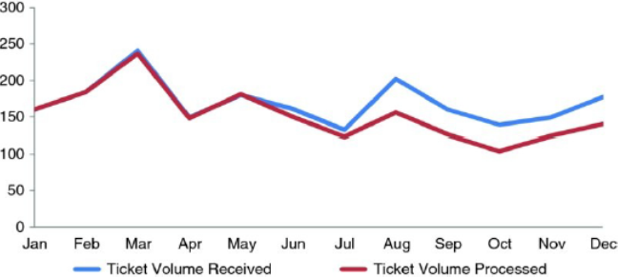
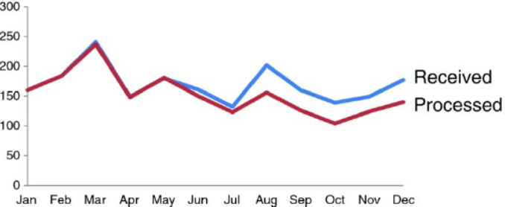
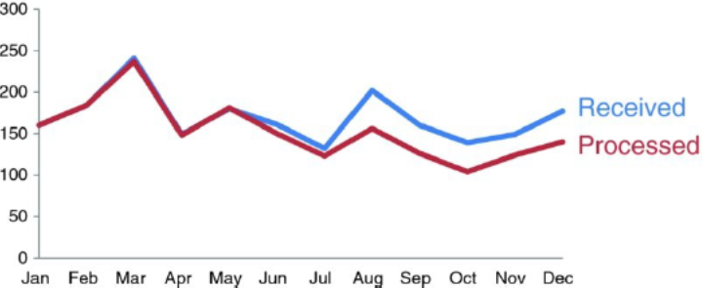
Example - cont
Step 4: Clean up axis labels
Step 5: Label data directly
Step 6: Consistent colour

